Slide 1
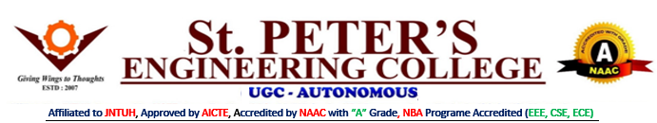
DEPARTMENT OF COMPUTER SCIENCE AND ENGINEERING
AND
INFORMATION TECHNOLOGY
MAJOR PROJECT
SECTION : INFORMATION TECHNOLOGY-B
BATCH : 04
S.No | Name | Roll No.
1. | PUNNA SAI GANESH | 21BK1A1298
2. | VANJARAPU BHANU CHARAN | 21BK1A12C3
3. | BELLAMKONDA RAGHU | 22BK5A1203
GUIDE
Dr. K. LITTLE FLOWER, PhD
Associate Professor

Slide 2
AI POWERED HEALTH CONNECT KIOSK

Slide 3
Agenda
Abstract
Introduction
Problem Statement
Objectives
Literature Survey
Methodology
System Architecture
Implementation
Expected Outcome
Challenges
References
Conclusion

Slide 4
Abstract
Healthcare in rural India suffers from inadequate infrastructure, a scarcity of medical professionals, and late diagnosis.
The paper presents an innovative solution—a kiosk based on AI-assisted telemedicine—designed to bridge the gap in healthcare for rural areas.
The kiosk takes advantage of cutting-edge technologies such as artificial intelligence to provide accessible, efficient, and reliable medical services.
The features are user-friendly in this system, such as the voice-to-text processing capability and disease prediction through a preprogrammed machine learning algorithm, as well as seamless doctor-patient connectivity.
Some enhancements for future development includes support for multiple languages, and improved user interfaces.

Slide 5
Introduction
Despite these challenges, the access to quality healthcare in rural India remains scarce due to the lack of medical professionals, infrastructure, and logistics.
This results in delayed diagnosis, inadequate treatment, and poor health outcomes for these underserved communities.
Telemedicine is a promising approach to addressing such challenges by providing remote consultations and diagnostics.
However, there is little scope in a rural setting because of a couple of factors related to costs, customization limitations, and technological constraints.
Accordingly, this paper has proposed an AI-assisted telemedicine kiosk for overcoming these limitations and delivering accessible, efficient, and reliable health services to the rural population.
Bridging the gap of the patient to the healthcare providers through the employment of advanced technology, including AI the kiosk will comprise the following as features: real-time consultation with the doctor, the AI-driven system that predicts a disease, and connecting it to the local workers to deliver on time medicines along with follow-ups.
This new system is aimed at transforming the delivery of health care in rural areas by fusing state-of the-art technology with grassroots healthcare networks, thus making quality medical services accessible to everyone.

Slide 6
Problem Statement
Healthcare accessibility in rural India is heavily constrained by the scarcity of medical professionals and insufficient infrastructure, thus causing delayed diagnosis and poor health outcomes.
In order to tackle these issues, the project presents an AI-based telemedicine robotic kiosk placed strategically in villages for seamless access to expert consultations through the e-sanjeevani App.
It is supported by local Asha workers to ensure that medicines are delivered on time and, thus, helps bridge the gap in healthcare for the people living in the rural areas.

Slide 7
Objectives
The major objectives of this AI-assisted telemedicine kiosk project are:
To ensure accessible healthcare services for the rural Indian population with a safe, user-friendly medical consultation platform.
Ensure timely delivery of medicines and essential services with the help of local Asha workers.
To utilize AI-based technologies for correct diagnosis, data management, and customized care.
To empower communities and ensure sustainable health outcomes.

Slide 8
Literature Survey
NAME | YEAR | AUTHOR NAME | TOOLS | ADVANTAGES | LIMITATIONS
Innovation in practice: mobile phone technology in patient care. | 2008 | Blake H | IOT methods are used for medical services | Accurate spatial representation, visual mapping | Dependency on GIS infrastructure, limited real-time updates
The recent progress and applications of digital technologies in healthcare: a review | 2020 | Senbekov M, Saliev T, Bukeyeva Z, Almabayeva A, Zhanaliyeva M, Aitenova N, Toishibekov Y, Fakhradiyev I | Digital technologies in healthcare | Improved accessibility, enhanced data management | Implementation challenges, data security concerns.
AutoImpilo: smart automated health machine using IoT to improve telemedicine and telehealth | 2021 | Ganesh D, Seshadri G, Sokkanarayanan S, Bose P, Rajan S, Sathiyanarayanan M | IoT-based smart health machine | Real-time monitoring, automation in telehealth | High initial cost, integration complexities

Slide 9
NAME | YEAR | AUTHOR 20NAME | TOOLS | ADVANTAGES | LIMITATIONS
Ensuring patient and public involvement in the transition to AI‐assisted mental health care: A systematic scoping review and agenda for design justice | 2021 | Zadar T, Morrow EM, Stockley R | AI-assisted mental health care | Increased patient engagement, improved mental health diagnosis | Ethical concerns, potential bias in AI models.
Health management via telemedicine: Learning from the COVID-19 experience | 2021 | Sun R, Blayney DW, Hernandez-Boussard T | Telemedicine platforms | Remote consultations, reduced healthcare burden | Digital divide, patient data privacy risks

Slide 10
Methodology
Step-by-step process:
User Registration & Authentication – Secure login using biometric authentication.
Symptom Entry & Chatbot Interaction – AI-based disease prediction using NLP & ML.
Prescription & Medicine Delivery – Asha workers deliver medications & health services.
Data Processing & Analysis – Extracts medical report details for further analysis.
Key Technologies Used:
AI Chatbot: NLP & ML for symptom-based predictions.
Speech-to-Text API: Converts voice inputs to text.
MySQL: Manages patient health records.
Django Framework: Web-based application backend.

Slide 11
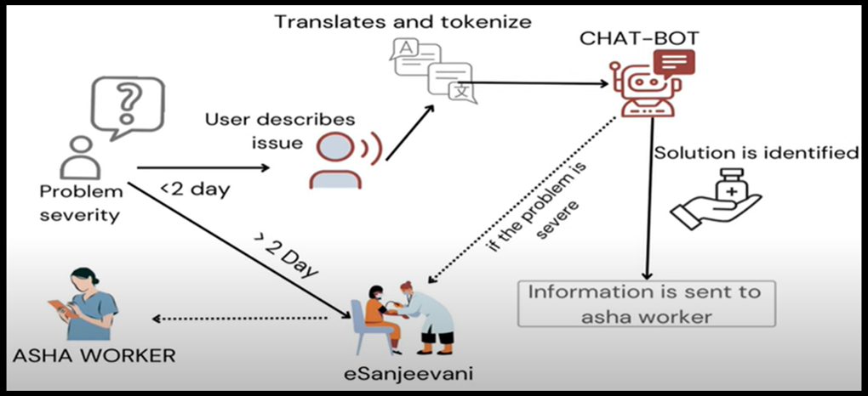
System Architecture
FIG-1.1: SYSTEM ARCHITECTURE

Slide 12
Implementation
REQUIREMENTS:
Processor : Intel i5/AMD Ryzen 5
Hard Disk : 500GB SSD
RAM : 8GB
Operating System : Windows 7/8/10/11
IDE : VS Code
Technology : PYTHON, DJANGO, HTML, CSS, JAVA SCRIPT, SQLyog
Development
Developed AI chatbot using NLP & ML models.
Integrated speech recognition for voice-based queries.
Developed secure patient login & authentication system.
Built MySQL database for patient record storage.
Next Steps:
Improve chatbot accuracy using more training data.
Test doctor-patient connectivity stability.
Deploy pilot kiosks in selected rural areas.

Slide 13
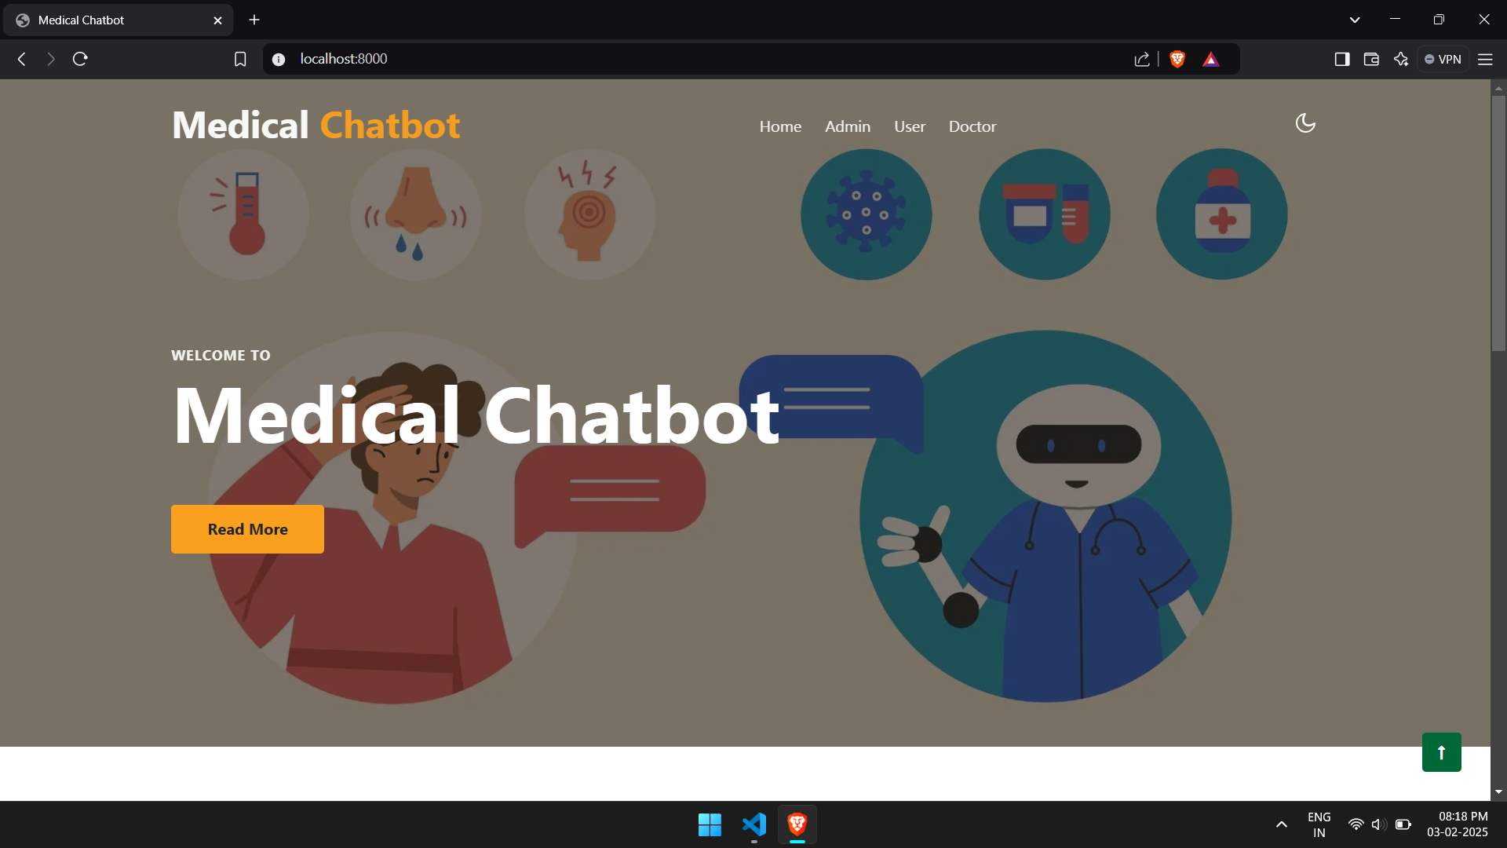
Expected Outcome
FIG-2.1: HOME PAGE

Slide 14
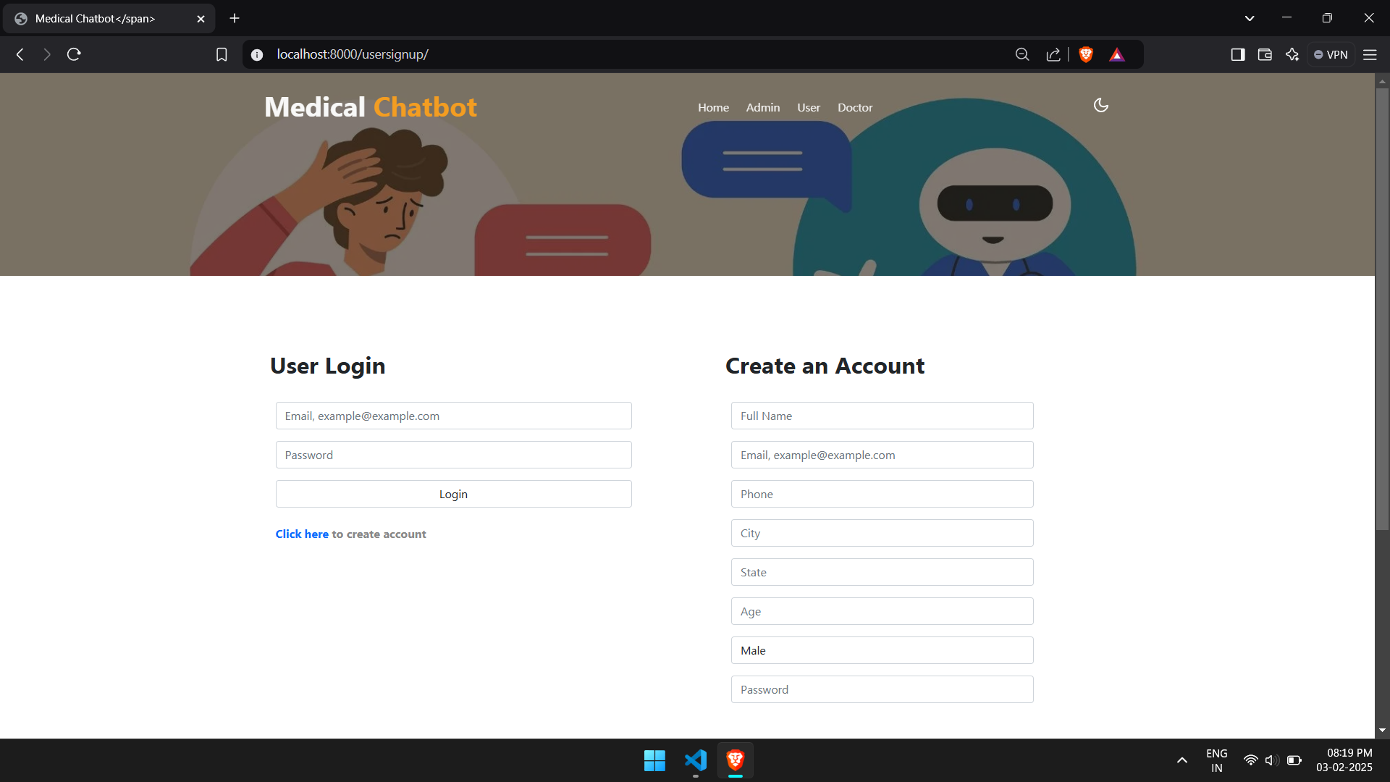
Expected Outcome
FIG-2.2: USER LOGIN PAGE

Slide 15
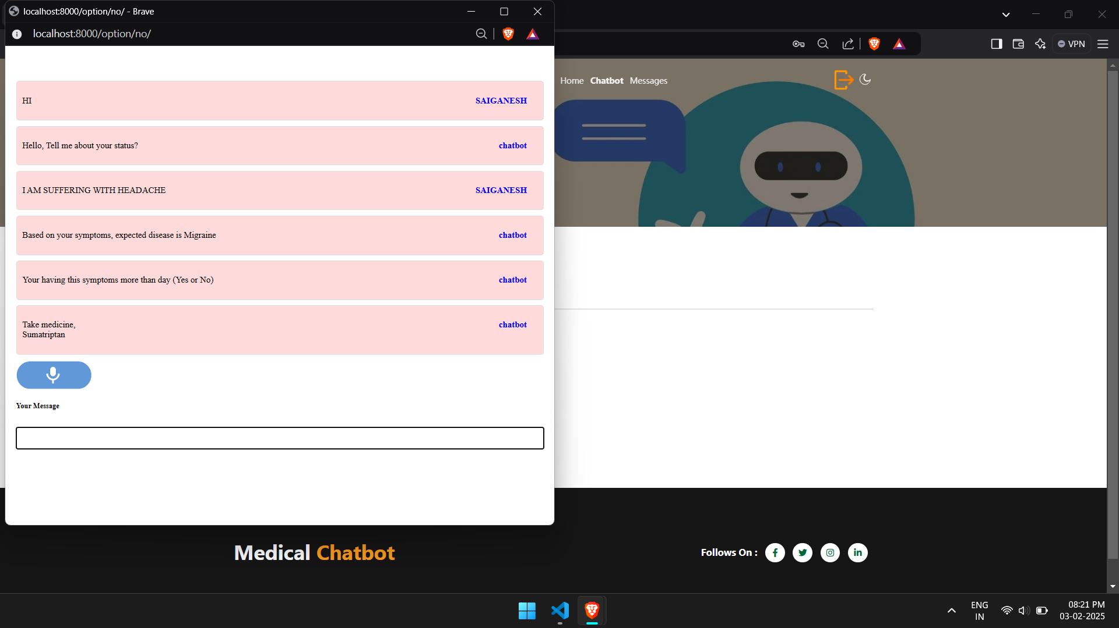
Expected Outcome
FIG-2.3: USER INTERACTION WITH CHATBOT

Slide 16
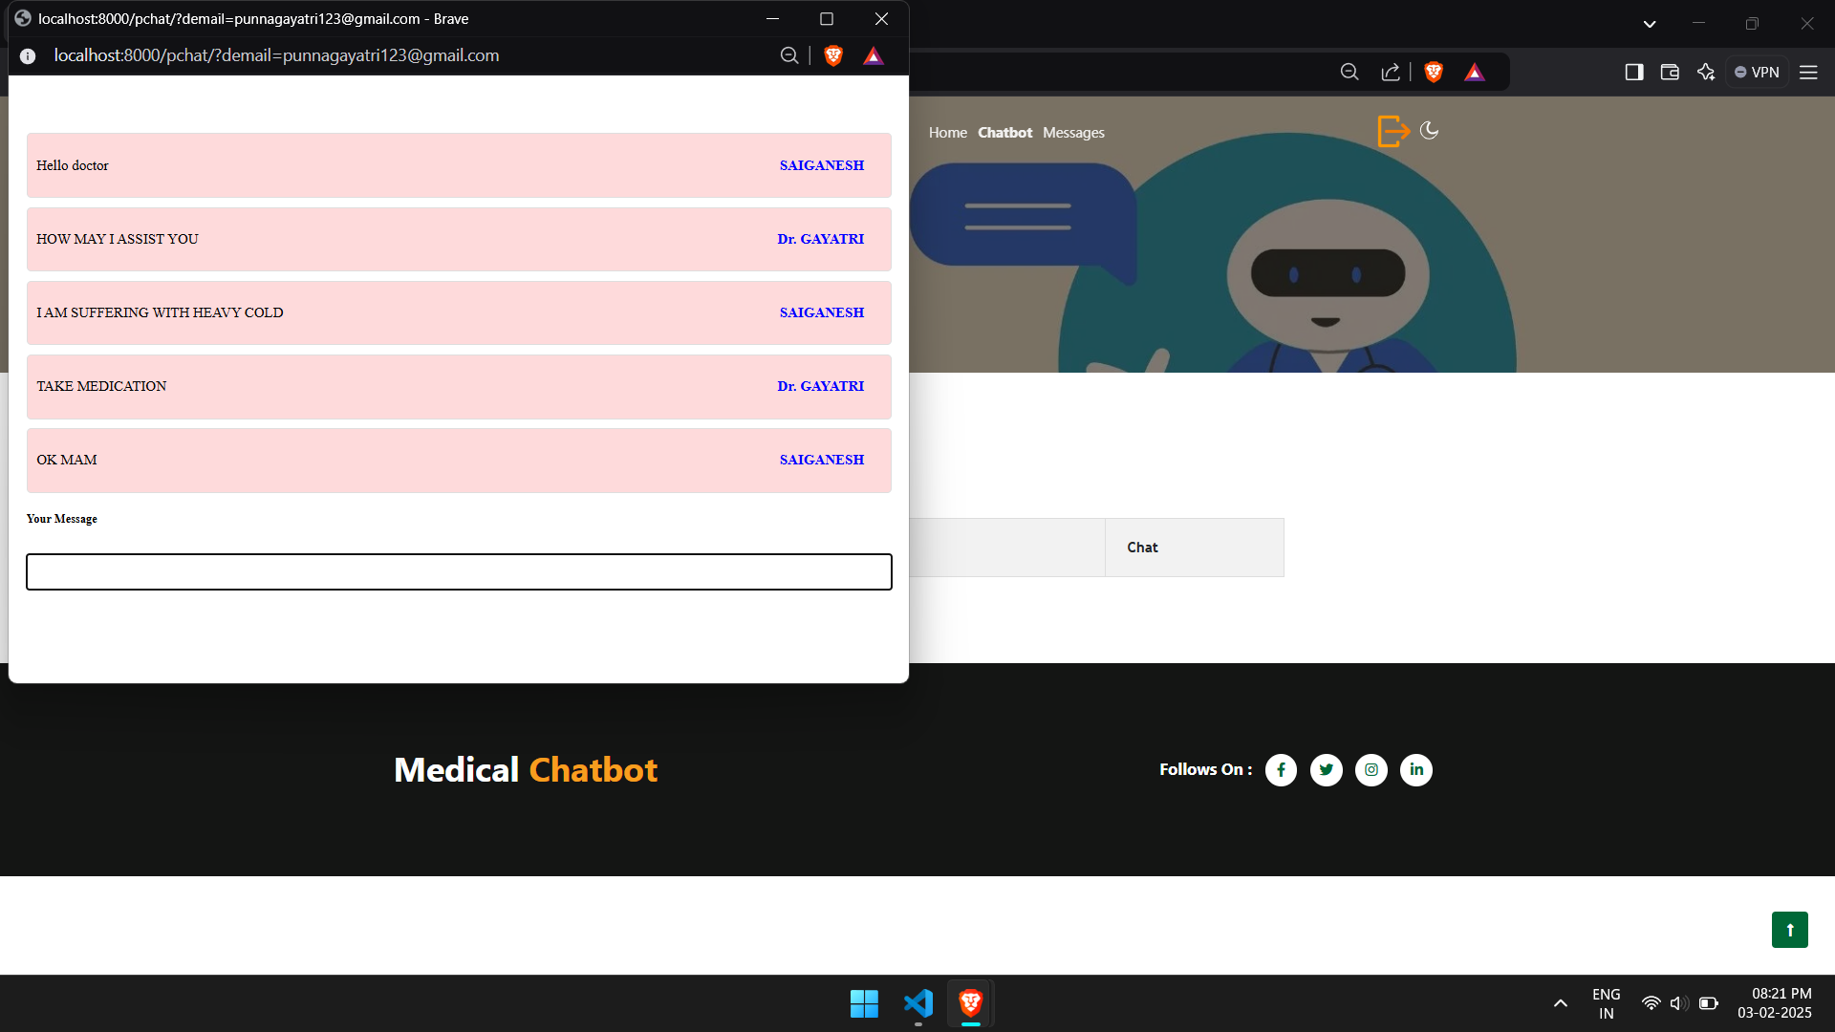
Expected Outcome
FIG-2.4: USER INTERACTION WITH DOCTOR

Slide 17
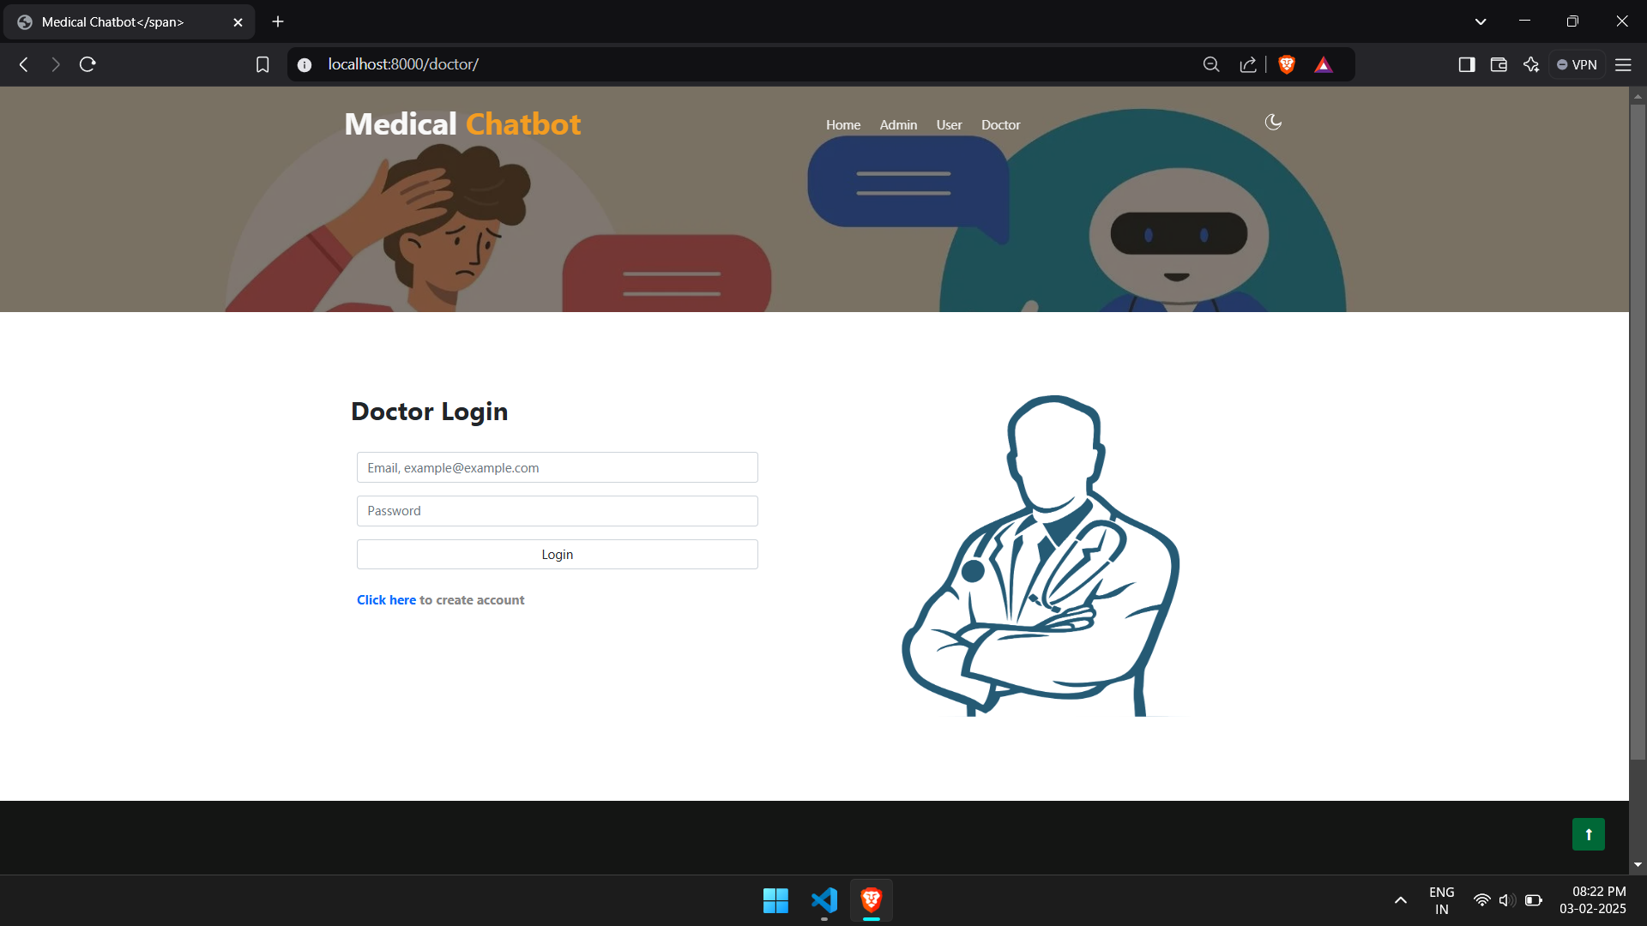
Expected Outcome
FIG-2.5: DOCTOR LOGIN PAGE

Slide 18
Challenges
Challenges Faced:
Internet connectivity issues in rural areas.
Limited AI training data for rural disease symptoms.
User adoption & literacy barriers for kiosk use.
Data privacy concerns for medical records.
Solutions:
Offline functionality for kiosks where possible.
Expand AI model training with rural healthcare datasets.
Use voice-based assistance for non-literate users.
Implement end-to-end encryption for patient record

Slide 19
References
Key Papers & Sources:
Blake H. Innovation in practice: mobile phone technology in patient care. British journal of community nursing. 2008 Apr;13(4):160-5.
https://doi.org/10.12968/bjcn.2008.13.4.29024
Senbekov M, Saliev T, Bukeyeva Z, Almabayeva A, Zhanaliyeva M, Aitenova N, Toishibekov Y, Fakhradiyev I. The recent progress and applications of digital technologies in healthcare: a review. International journal of telemedicine and applications. 2020;2020(1):8830200.
https://doi.org/10.1155/2020/8830200
Ganesh D, Seshadri G, Sokkanarayanan S, Bose P, Rajan S, Sathiyanarayanan M. AutoImpilo: smart automated health machine using IoT to improve telemedicine and telehealth. In2020 International Conference on Smart Technologies in Computing, (ICSTCEE) 2020 Oct 9 (pp. 487-493).
https://doi.org/10.1109/ICSTCEE49637.2020.9277223
Zadar T, Morrow EM, Stockley R. Ensuring patient and public involvement in the transition to AI‐assisted mental health care: A systematic scoping review and agenda for design justice. Health Expectations. 2021 Aug;24(4):1072-124.
https://doi.org/10.1111/hex.13299
Sun R, Blayney DW, Hernandez-Boussard T. Health management via telemedicine: Learning from the COVID-19 experience. Journal of the American Medical Informatics Association. 2021 Nov 1;28(11):2536-40.
https://doi.org/10.1093/jamia/ocab145

Slide 20
Conclusion
The AI-Powered Health Connect Kiosk is a scalable, AI-driven healthcare solution that can transform rural medical accessibility.
Telemedicine integration bridges the doctor shortage.
AI chatbot assists in early disease detection.
Asha workers ensure medicine delivery.

